Slide 1
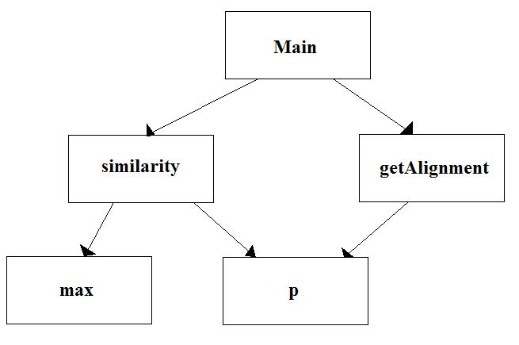
Adrian Flannery
Bioinformatics II
Assignment 3

